Slide 1
Software Engineering
KCS- 601
Lecture #

Slide 2
Rapid Application Development(RAD)Model
Is a linear sequential software development process model that emphasizes an extremely short development cycle.
Achieved by using a Component Based Construction approach.
If requirements are well understood and project scope is constrained the RAD process enables a development team to create a ―”fully functional system” within very short time periods (e.g., 60 to 90 days).

Slide 3
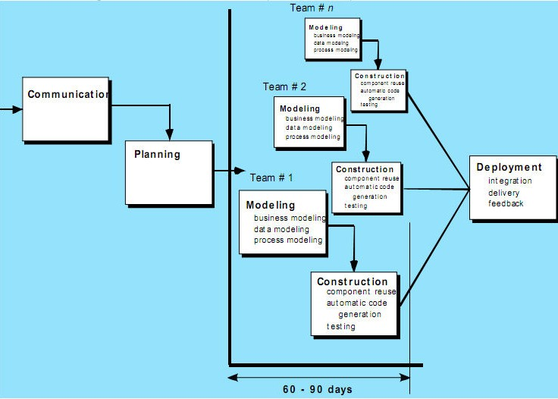

Slide 4
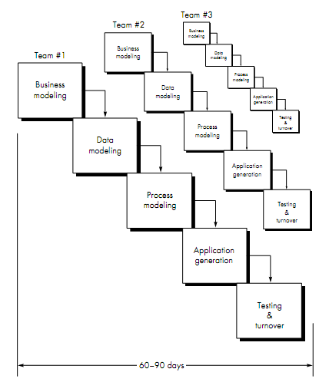

NPTEL
Coursera
Internet
Above all…

Slide 5
RAD Phases :
Business modeling.
Data modeling.
Process modeling.
Application generation.
Testing and turnover.
Notes:
The title of this course (at UF) is “Applications of Discrete Structures.” Actually that title is misleading. Although discrete math has many applications, which we’ll survey in a moment, this class is not really about applications so much as it is about basic mathematical skills and concepts. My guess is that the only reason we call the course “Applications of Discrete Structures” rather than just “Discrete Mathematics” so that the people over in the Math department don’t get upset that we’re teaching our own basic math course over here, rather than leaving it to them.
Anyway, that issue aside, you may be wondering, what is a “discrete structure” anyway? Well, by “discrete” we don’t mean something that’s kept secret – that’s “discreet” with a double-e, a homonym, a completely different English word with a completely different meaning. No, our word “discrete” just means something made of distinct, atomic parts, as opposed to something that is smooth and continuous, like the curves you studied in calculus. Later in the course we’ll learn how to formalize this distinction more precisely using the concepts of countable versus uncountable sets. But for now, this intuitive concept suffices.
By “structures” we just mean objects that can be built up from simpler objects according to some definite, regular pattern, as opposed to unstructured, amorphous blobs. In this course, we’ll see how various types of discrete mathematical objects can be built up from other discrete objects in a well-defined way.
The field of discrete mathematics can be summarized as the study of discrete, mathematical (that is, well-defined, conceptual) objects, both primitive objects and more complex structures.

Slide 6
RAD Phases involve:
Business Modeling:
  The information ﬂow among business functions is
modeled in a way that answers the following questions-
    Where does information come from and go ?
    Who processes it ?
    What information drives the business process?
    What information is generated ?
Data Modeling:
  The information flow defined as part of the business modeling phase is refined into a set of data objects that are needed to support the business.
  The characteristics (called attributes) of each object are identified and the relationships between these objects are defined.

Slide 7
Process modeling:
  The data modeling phase are transformed to achieve the information flow necessary to implement a business function.
  To add, modify, delete, or retain a data object, there is a
need for description which is done in this phase.
Application generation:
  RAD assumes the use of 4 generation techniques.
  Rather than creating software using conventional 3 generation programming languages, the RAD process works to reuse existing program components (when possible) or created reusable components (when necessary).

Slide 8
Testing and Turnover:
  Since the RAD process emphasizes reuse, many of the program components have already been tested.
  So we use some these already existing programs which are already tested.
  This reduces over all testing time.
  However, new components must be tested and all interfaces
must be fully exercised.

Slide 9
Advantages & Disadvantages of RAD:
Advantages-
1.Reduced development time.
2.Uses component-based construction and emphasizes reuse and code generation.(Increases reusability of components)
3.Quick initial reviews occur
4.Encourages customer feedback
5.Integration from very beginning solves a lot of integration issues.

Slide 10
Disadvantages-
For large, but scalable projects, RAD requires sufficient human resources to create the right number of RAD teams.
Requires strong commitment between developers and customers for “rapid-fire” activities
High performance requirements maybe can’t meet (requires tuning the components).
Depends on strong team and individual performances for identifying business requirements.
Only system that can be modularized can be built using RAD
Requires highly skilled developers/designers.
High dependency on modeling skills
Inapplicable to cheaper projects as cost of modeling and automated code generation is very high

Slide 11
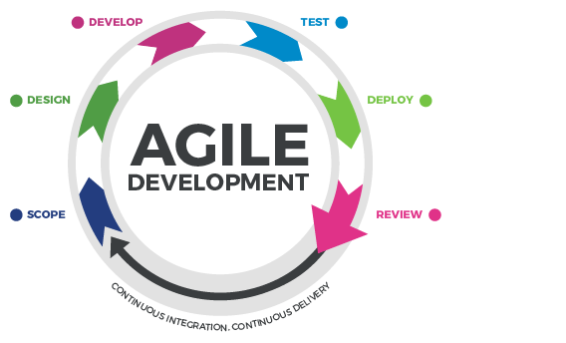
Agile Software Development
It is a conceptual framework for software engineering that develops iterations(module developed during one unit of time) throughout the life-cycle of the project.
Proposed in mid 1990’s.
It is light and active software development process. We get continuous output on the basis of iterative feedback.
It promotes adaptive planning, evolutionary development and delivery, a time-boxed iterative approach, and encourages rapid and flexible response to change.
Requirements are broken into smaller tasks which are incrementally developed over shorter period of time.

Slide 12
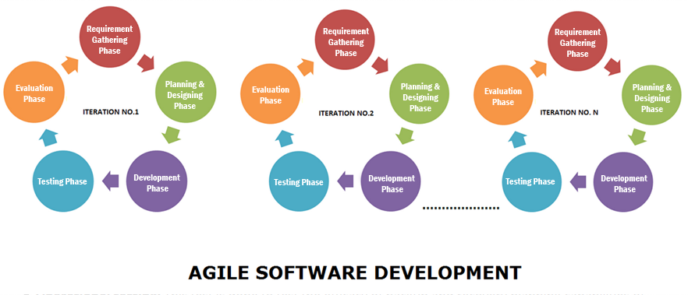
Agile Software Development

Slide 13
Traditional Model Vs. Agile Model
TRADITIONAL
Up front Design
Fixed scope
Deliverables
Freeze design as early as possible
Low uncertainty
Avoid change
Low customer interaction
Conventional project teams
AGILE
Continuous design
Flexible
Features/Requirements
Freeze design as late as possible
High uncertainty
Embrace change
High customer interaction
Self-organized project teams

Slide 14
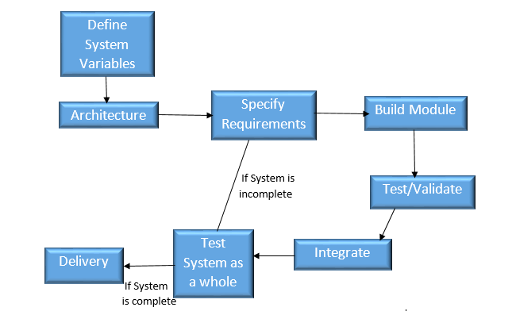
Agile Process

Slide 15
Agile Principles
There are 12 principles in agile, listed below:
Our highest priority is to satisfy the customer through early and continuous delivery of valuable software.
Welcome changing requirements, even late in development. Agile processes harness change for the customer’s competitive advantage.
Deliver working software frequently, from a couple of weeks to a couple of months, with a preference to the shorter timescale.
Business people and developers must work together daily throughout the project.
Build projects around motivated individuals. Give them the environment and support they need, and trust them to get the job done.

Slide 16
The most efficient and effective method of conveying information to and within a development team is face-to-face conversation.
Working software is the primary measure of progress.
Agile processes promote sustainable development. The sponsors, developers, and users should be able to maintain a constant pace indefinitely.
Continuous attention to technical excellence and good design enhances agility.
Simplicity–the art of maximizing the amount of work not done–is essential.
The best architectures, requirements, and designs emerge from self-organizing teams.
At regular intervals, the team reflects on how to become more effective, then tunes and adjusts its behaviour accordingly.

Slide 17
Advantages of Agile
Changes are easily accommodated and accepted.
Agile is beneficial to the projects where end goal is not clearly defined.
Faster and high quality delivery.
Agile highlights the importance of frequent communication and face-to-face interactions.
Increased customers interactions.
Continuous improvement.

Slide 18
Disadvantages of Agile
At times planning can be less concrete because of the continuous change in requirements by the customer.
Team members must be highly skilled and must be comfortable while working in agile environment.
Active involvement and collaboration is required throughout the Agile process, which is more time consuming than a traditional approach.
No proper documentation is done.
Final product can be different because initial agile project might not have a definite plan, customer keeps on adding the functionalities whenever needed so the final product may vary from the initial mentioned one.

